Slide 1
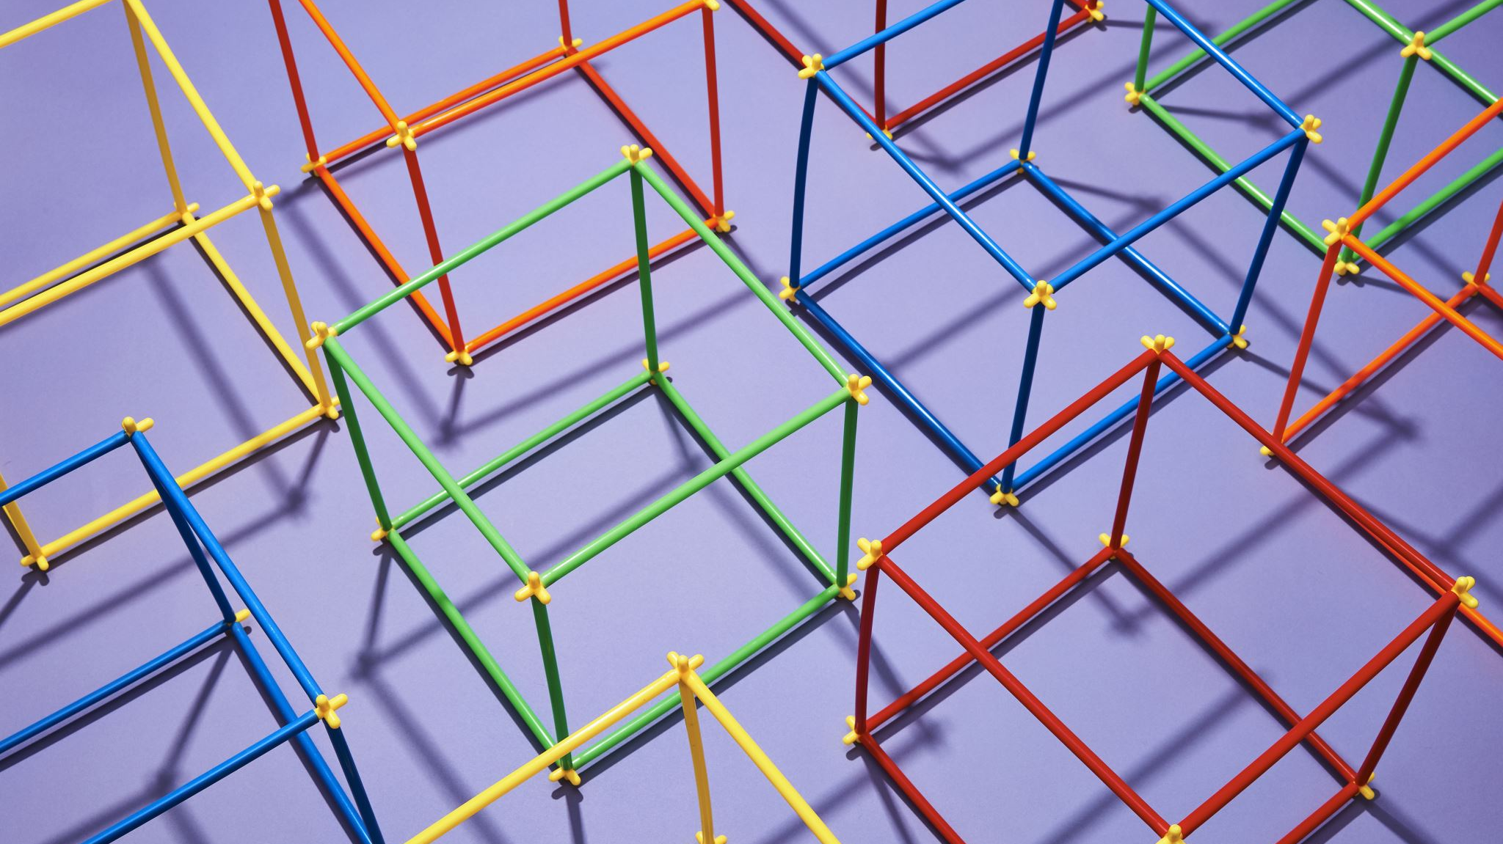
FAKE PRODUCT IDENTIFICATION SYSTEM USING BLOCKCHAIN TECHNOLOGY
PROJECT COORDINATOR:
SRINIVASAN.S HOD/CSE
PROJECT GUIDE:
SATHYA.A AP/CSE
PROJECT MEMBERS:
1)KARTHICKEYAN R(513519104014)
2)SATHISHKUMAR P(513519104030)
3)THANGARAJ S(513519104036)
4)ABINASH B(513519104301)

Slide 2
abstract
In recent years, Counterfeit products play an important role in product manufacturing industries.
This affects the companies name, sales, and profit of the companies. Blockchain technology is used to identification of real products and detects fake products.
Blockchain technology is the distributed, decentralized, and digital ledger that stores transactional information in the form of blocks in many databases which is connected with the chains. Blockchain technology is secure technology therefore any block cannot be changed or hacked.
By using Blockchain technology, customers or users do not need to rely on third-party users for confirmation of product safety.
In this project, with emerging trends in mobile and wireless technology, Quick Response (QR) codes provide a robust technique to fight the practice of counterfeiting the products. counterfeit products are detected using a QR code scanner, where a QR code of the product is linked to a Blockchain.

Slide 3
PROPOSED MODEL
If the original manufacturer embeds a QR code on the product that is linked to the blockchain system, one could scan the QR code which would tell whether the product is fake or not.
Suppose we come across a counterfeit item – we need to be able to identify that it is indeed fake through its QR code, verified across a blockchain. A hacker attempting to add said counterfeit QR through the blockchain must find it impossible to modify the chain.
Each product has a blockchain and each block in the blockchain will have a set of transactions that are associated with the product.
Each block will consist of –
a unique index (to differentiate between transactions)
timestamp (when the block was created)
verification code
proof
set of transactions Suppose a person wants to buy a specific product. They must: • Verify the QR code of the product with the blockchain to verify the product’s validity, Insert the transaction data into a block while checking against it with the proof/nonce, wait for the block to be verified across all the decentralized database so it can be inserted into the blockchain. • Additionally, the blockchain must be resilient to attacks and modifications to the product list by unknown sources

Slide 4

EXISTING MODEL
• Generate the electronic file of a paper QR Code And calculate the hash value for it and store the hash value into the block
• The system creates a QR-code string code to affix to the paper QR Code used to verify the authenticity of the paper QR Code through Mobile phone scanning.
• Every popular brand has fake manufacturers selling a counterfeit item with misleading and invalid labels, which are sold at cheaper rates. Even the company experts may not be able to distinguish between counterfeit and original items.
Disadvantages of existing system:
QR-code must be scanned with smartphone and internet connection is also required.
Hyperledger cannot use public blockchain because of privacy and low scalability.
Hyperledger preferred platform only for B2B business.

Slide 5
SYSTEM REQUIREMENTS
Software Requirements:
Front End – Anaconda IDE or sublime text editor
Backend – SQL
Language – Python 3.8
Hardware Requirements:
Hard Disk: Greater than 500 GB
RAM: Greater than 4 GB
Processor: I3 and Above

Slide 6
LITERATURE SURVEY
Satoshi Nakamoto
"A new electronic cash system that uses a peer-to-peer network to prevent double-spending. It is completely decentralized with no central authority or server" – Satoshi Nakamoto, 09 January 2009, announcing Bitcoin on Source Forge [4]. It is a digital currency system based on peer-to-peer virtual data [5]. It uses peer-to-peer technology or network to operate with no central authority or banks; managing transactions and the issuing of Bitcoin is carried out collectively by the system. Bitcoin is 1 st cryptocurrency that usages Cryptography to control its creation and transactions, rather than a central authority. It provides a new payment system that is digital in nature and no central authority/mediators are involved. It can be considered as “Cash for Internet”.

Slide 7
LITERATURE SURVEY(continue)
Ethereum
Ethereum was developed by the Ethereum Foundation (a Swiss non-profit foundation). It was released in 2015, and its symbol is ETH. It is a distributed SW platform that use Smart contract to interact with the blockchain. Application based on Ethereum runs without any fraud and 3 rd. party validation.

Slide 8
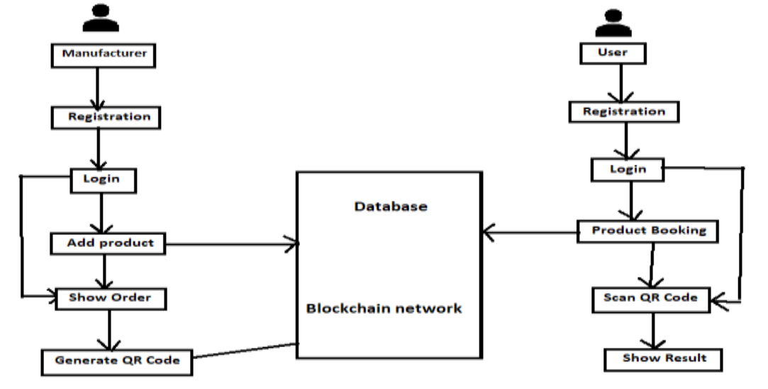
ARCHITECTURE DIAGRAM

Slide 9
SYSTEM DESIGN
UNIFIED MODELING LANUAGE:
UML stands for Unified Modeling Language.
It is a third generation method for specifying, visualizing and documenting the artifacts of an object oriented system under development.
Object modeling is the process by which the logical objects in the real world (problem space) are represented (mapped) by the actual objects in the program (logical or a mini world).
This visual representation of the objects, their relationships and their structures is for the ease of understanding.
This is a step while developing any product after analysis.

Slide 10
UNIFIED MODELING LANUAGE(CONTINUE):
The Unified Modeling Language encompasses a number of models.
Use case diagrams
Class diagrams
Sequence diagrams

Slide 11
USE CASE DIAGRAM:
Use case diagram consists of use cases and actors and shows the interaction between them. The key points are:
The main purpose is to show the interaction between the use cases and the actor.
To represent the system requirement from user’s perspective.
The use cases are the functions that are to be performed in the module.
An actor could be the end-user of the system or an external system.

Slide 12
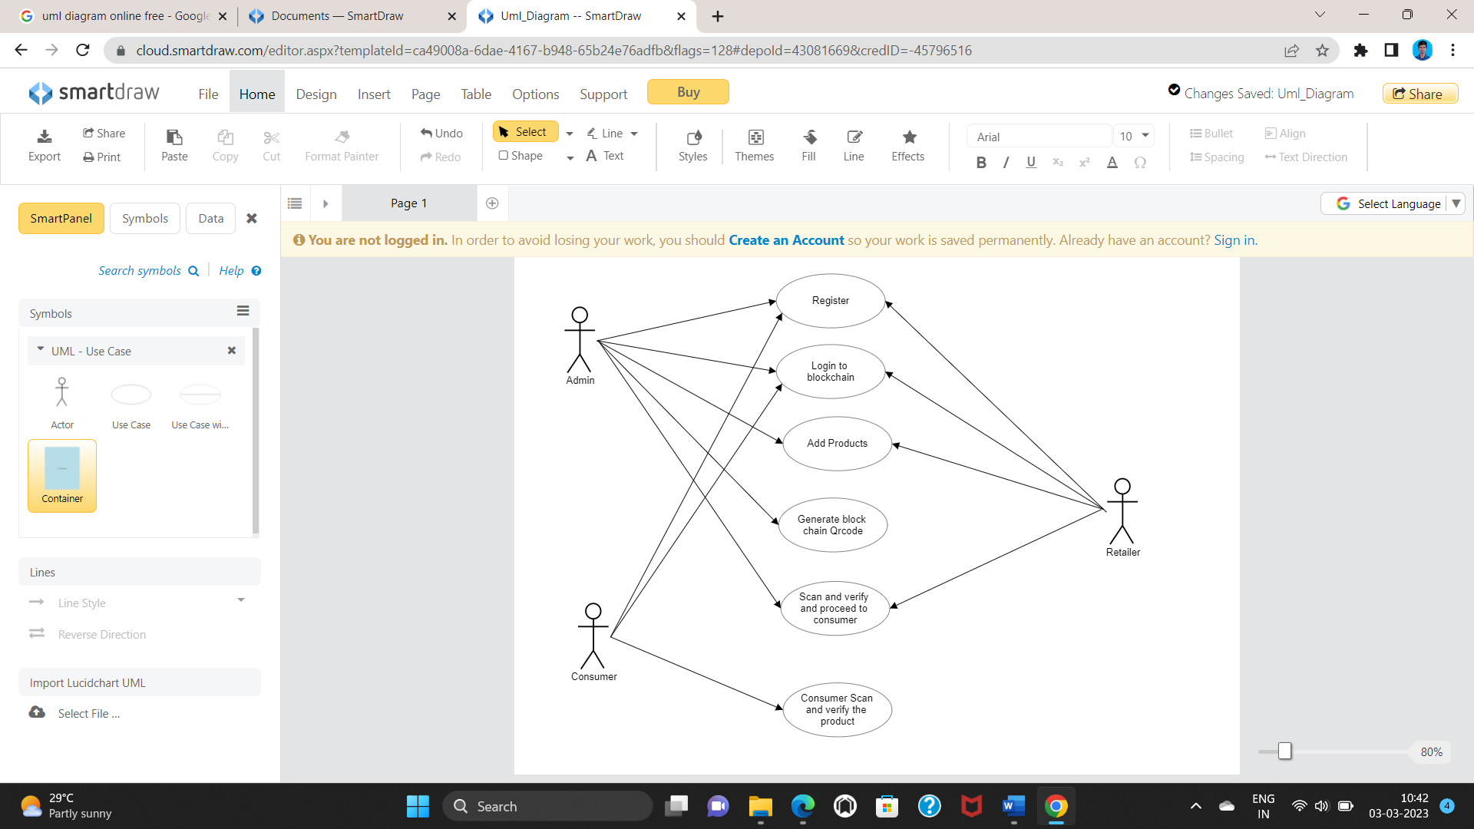

Slide 13
SEQUENCE DIAGRAM:
The purpose of sequence diagram is to show the flow of functionality through a use case.
In other words, we call it a mapping process in terms of data transfers from the actor through the corresponding objects.

Slide 14
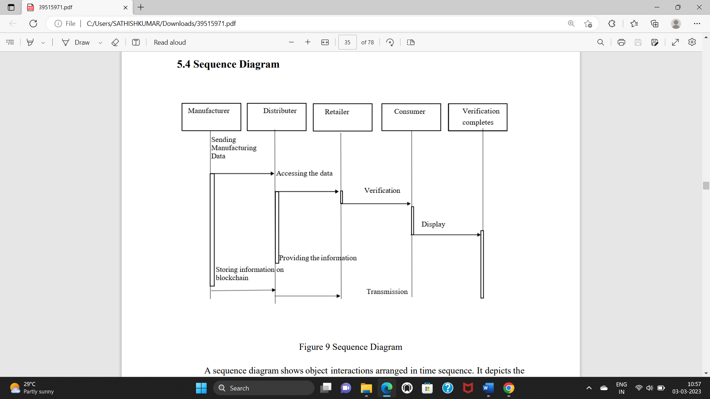

Slide 15
CLASS DIAGRAM:
A class diagram is an illustration of the relationships and source code dependencies among classes in the Unified Modeling Language (UML).
In this context, a class defines the methods and variables in an object, which is a specific entity in a program or the unit of code representing that entity.

Slide 16
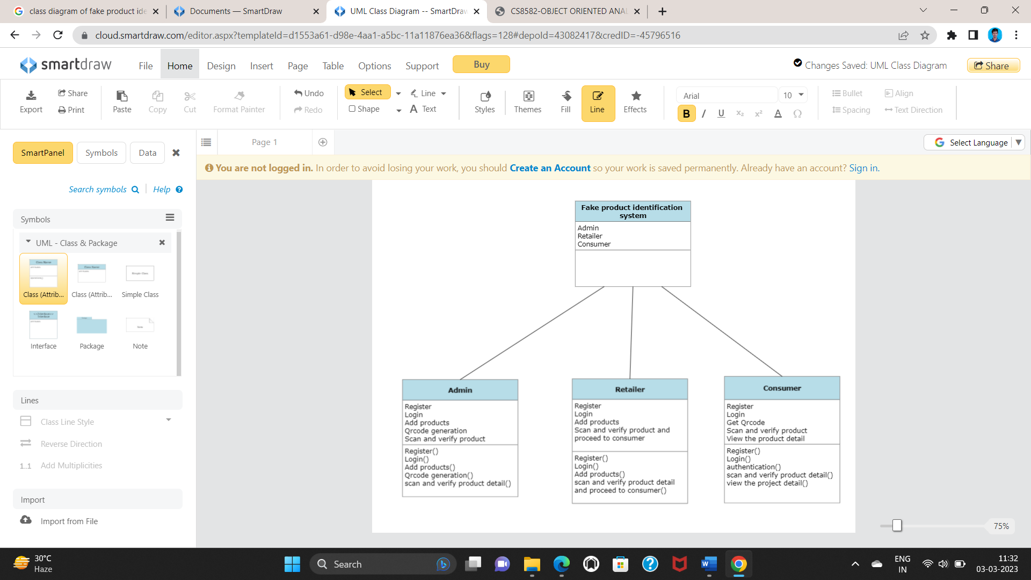

Slide 17
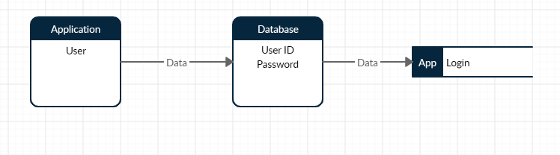
Dataflow diagram:
LEVEL 1:
LOGIN

Slide 18
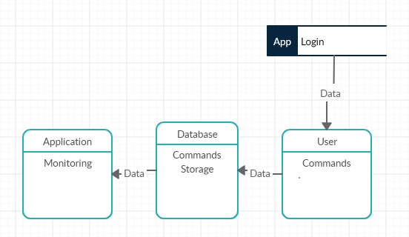
Dataflow diagram(CONTINUE):
LEVEL 2
USER

Slide 19
MODULES:
USER MODULE
ADMIN MODULE
BLOCKCHAIN CREATION
VERIFICATION

Slide 20
USER MODULES:
LOGIN: In this section, user can login with our name and password to entering page of product details.
ADD PRODUCT: In this section, user can be providing the product details and submit.
QRCODE: The submitted product details is convert a qrcode using block chain technology and it store the database of SQLite .And user verify the product is fake or not using qrcode scanner. If it is not fake it shows the verified successful and show the product details.

Slide 21
ADMIN MODULES:
LOGIN: In this section, Admin can login with our name and password to entering page of product details.
ADD PRODUCT: In this section, Admin can be providing the product details and submit.
QRCODE: The submitted product details is convert a qrcode using block chain technology and it store the database of SQLite. And Admin verify the product is fake or not using qrcode scanner. If it is not fake it shows the verified successful and show the product details.

Slide 22
BLOCKCHAIN CREATION:
A block is a container data structure. The average size of a block seems to be 1MB (source).
Here every QR Codes number will be created as a block.
For every block an hash code will generate for security.
In this module, based on QR Code numbers Block code will generate.
While creating Blockchain code user can increase the count based on their needs.
The major advantage of this module user can share the Block chain code to another person in case of necessity.
When user scan the QR Code an OTP will be send to the registered mobile for verification.

Slide 23
VERIFICATION MODULE:
In this module user will upload the QR Codes like Products and so on.
Before upload, those QR Codes will verified by the corresponding sector ,if we upload product QR Code, the QR Code number will check with corresponds product database server if that QR Code is verified after that it will stored on server otherwise it will discard.

Slide 24
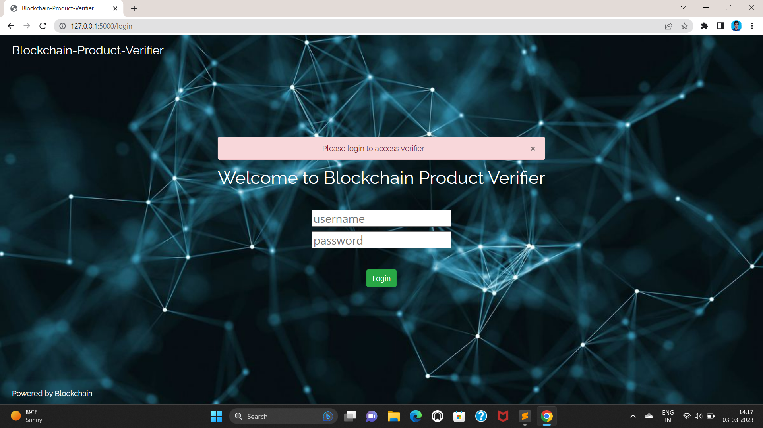
ADMIN MODULE1: Login Page: In this section, Admin can register and Login to the page.

Slide 25
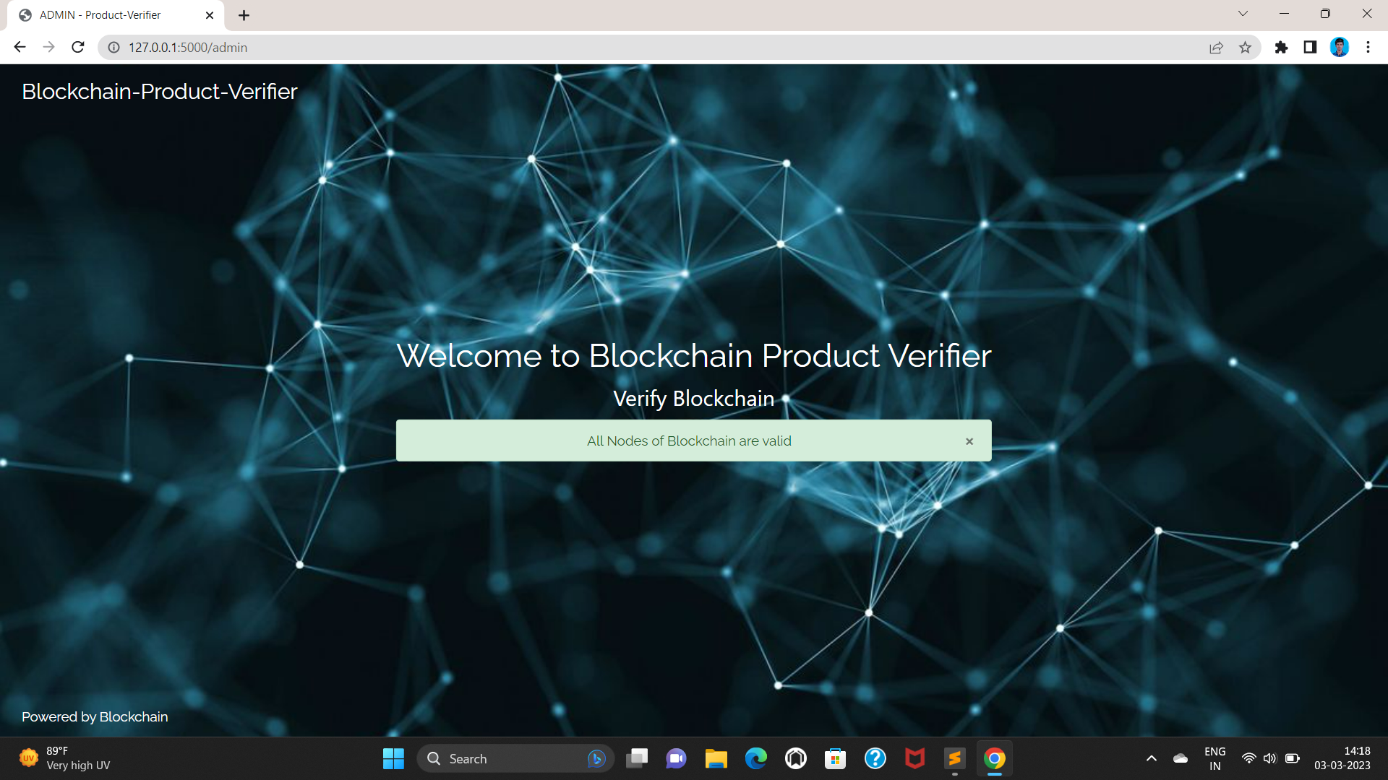
ADMIN MODULE2: Admin Page: In this section admin to verify the blockchain nodes

Slide 26
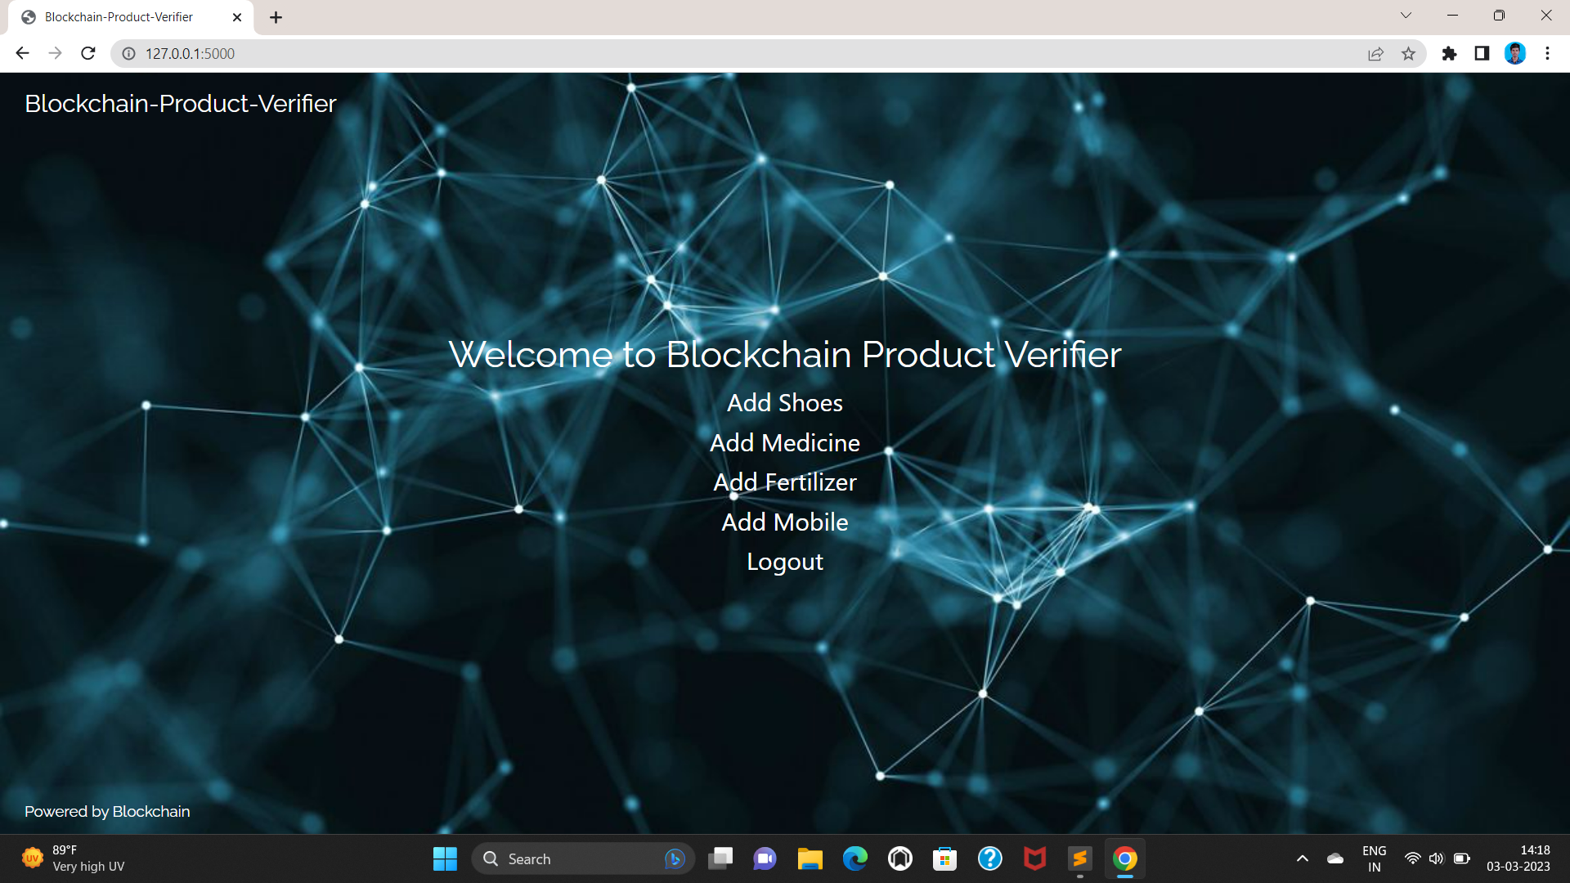
ADMIN MODULE3: Add Product Page: In this section admin can add the product details

Slide 27
USER MODULE1: Login Page: In this section, Admin can register and Login to the page.

Slide 28
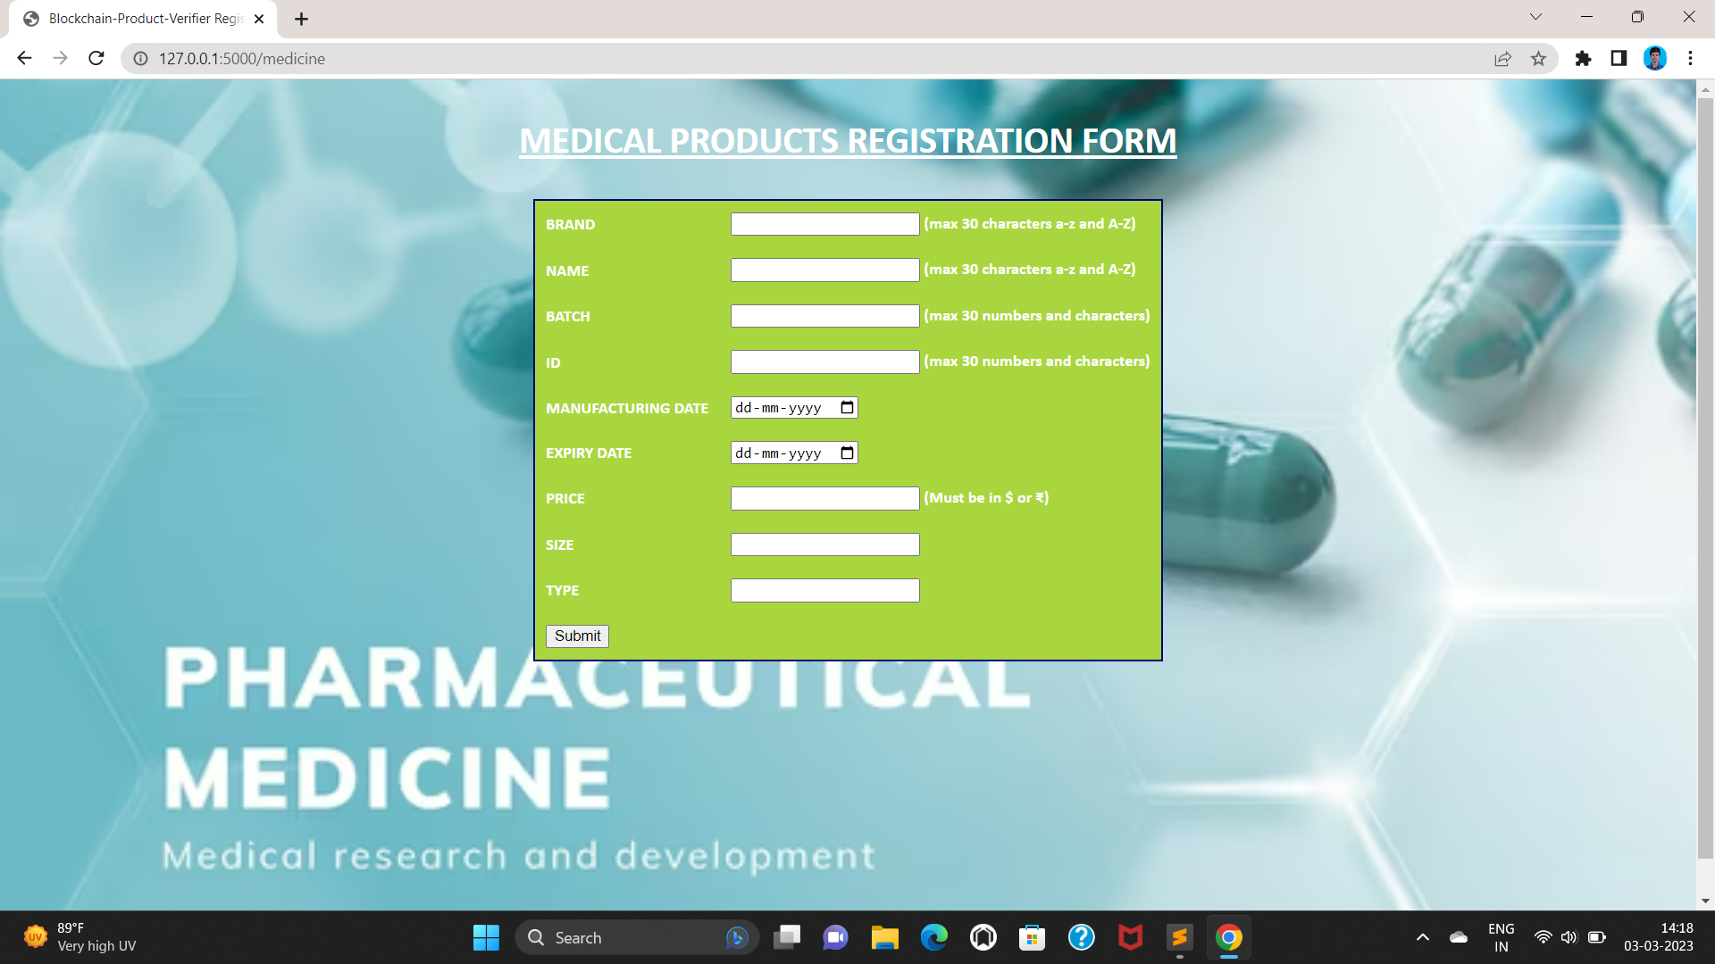
ADD PRODUCT OF MEDICINE PAGE: In This Section Admin And Retailer Add Medicine Product Details

Slide 29
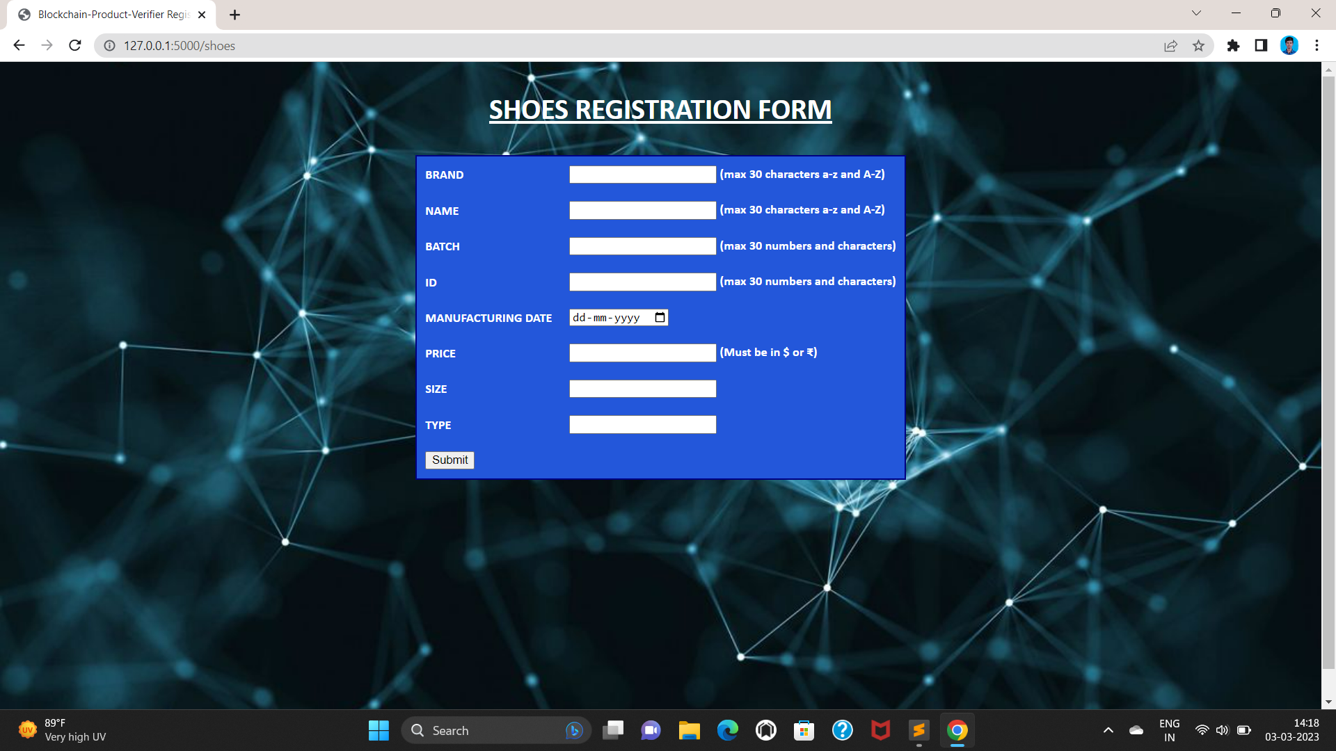
ADD PRODUCT OF SHOES PAGE: In This Section Admin And Retailer Add Shoes Product Details

Slide 30
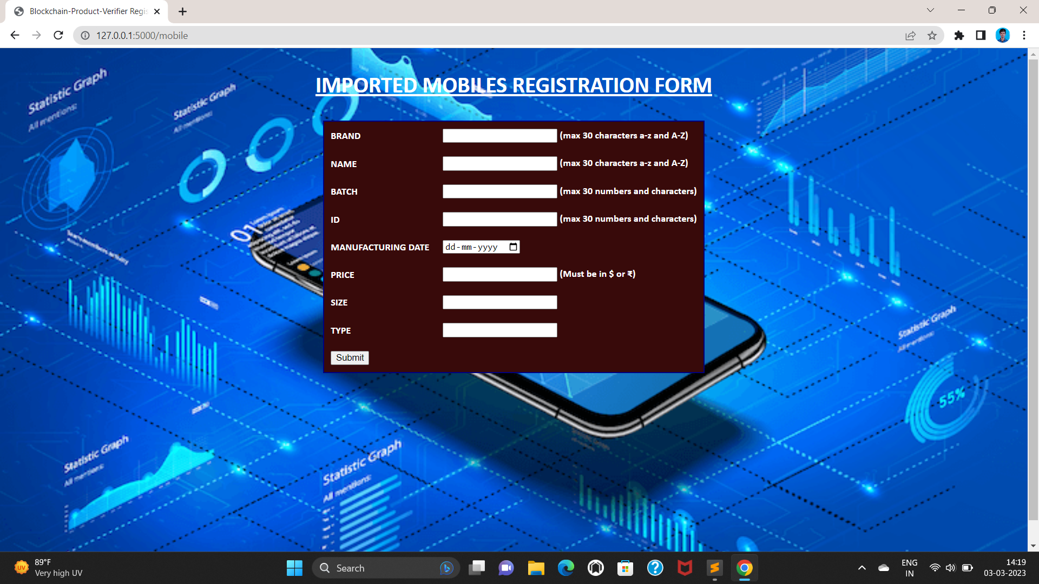
ADD PRODUCT OF MOBILE PAGE: In This Section Admin And Retailer Add Mobile Product Details

Slide 31
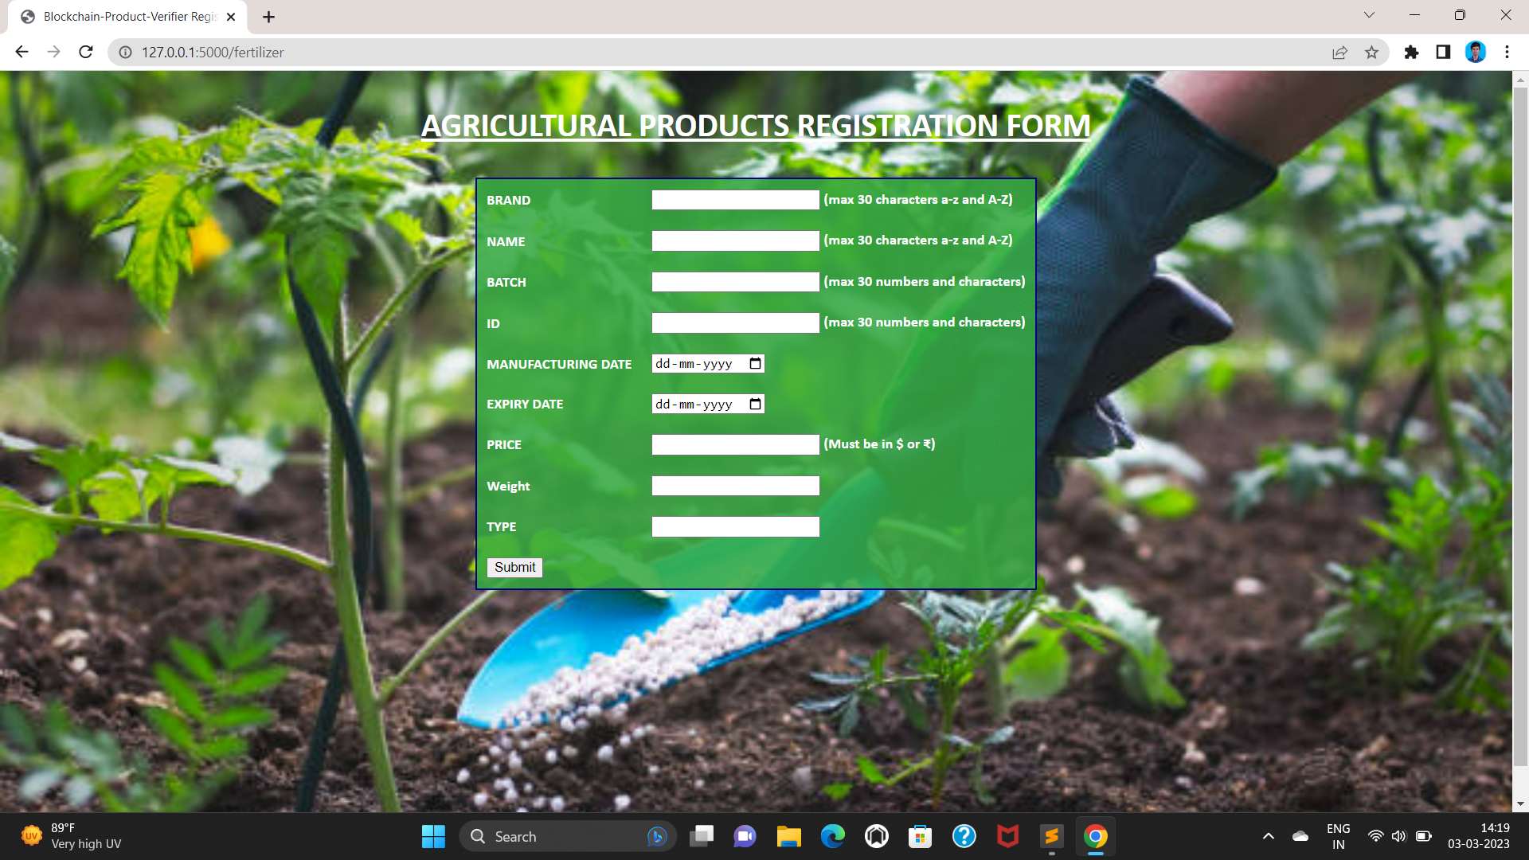
ADD PRODUCT OF FERTILIZER PAGE: In This Section Admin And Retailer Add Fertilizer Product Details

Slide 32
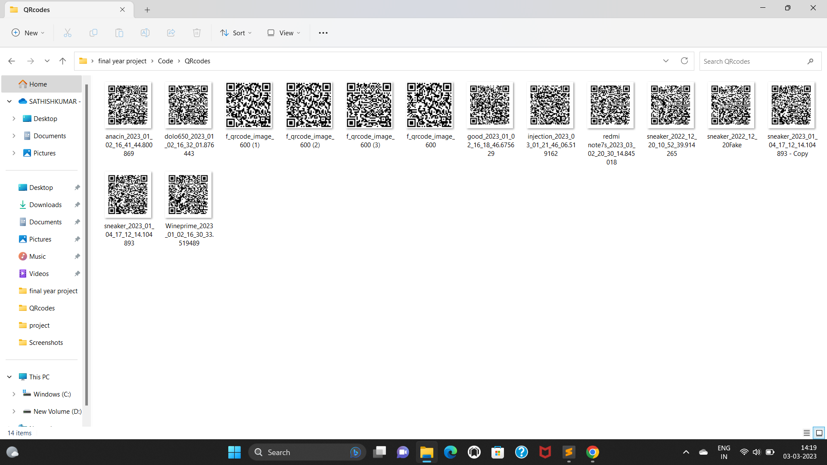
BLOCKCHAIN QRCODE GENERATION AND SCANNING MODULE1: In This Section Admin Generate The Product Details To Blockchain Qrcode And Stored In Sqlite Database.

Slide 33
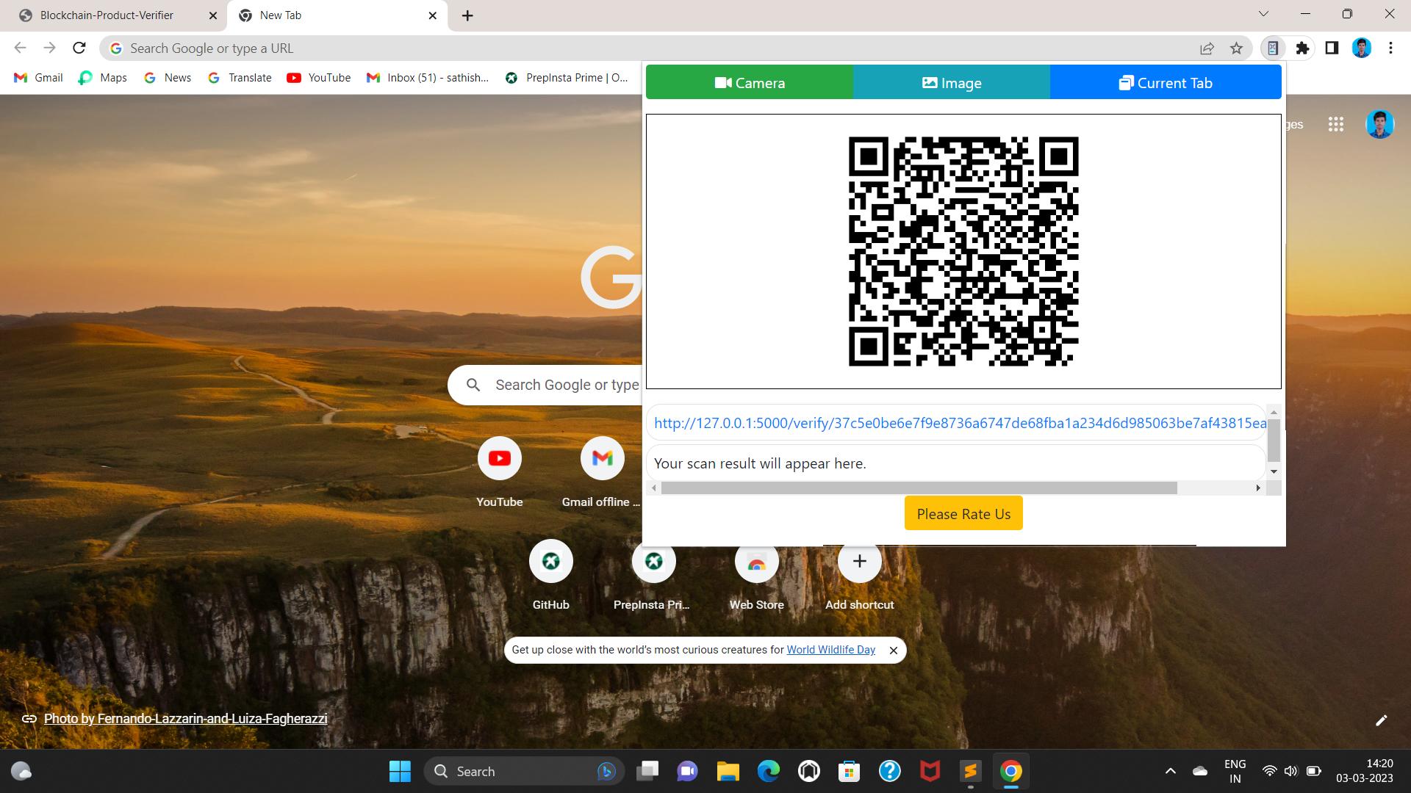
BLOCKCHAIN QRCODE GENERATION AND SCANNING MODULE2: In This Section Admin And consumer scanning The Product Qrcode using scanner.

Slide 34
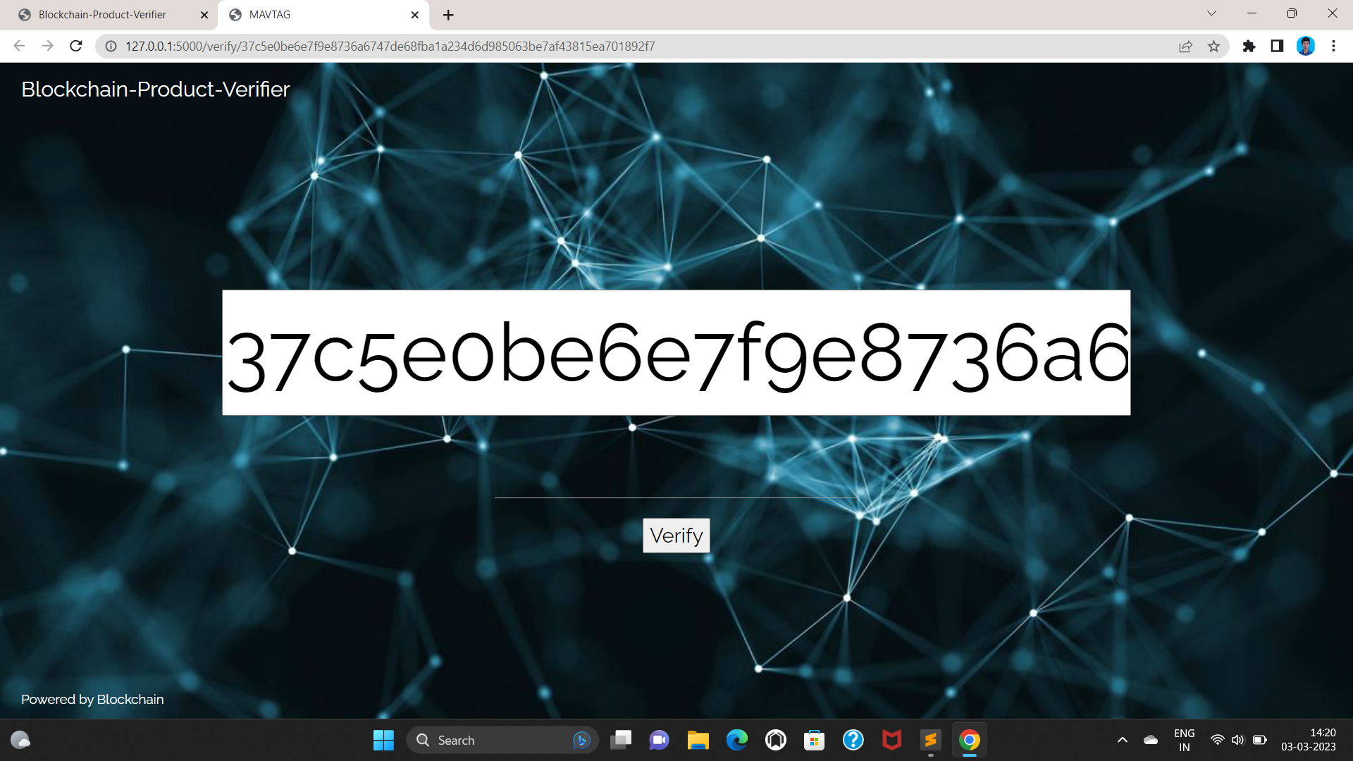
VERIFICATION MODULE1: Verification Page: In This Section Admin And consumer to be verify the qrcode to the value of the product.

Slide 35
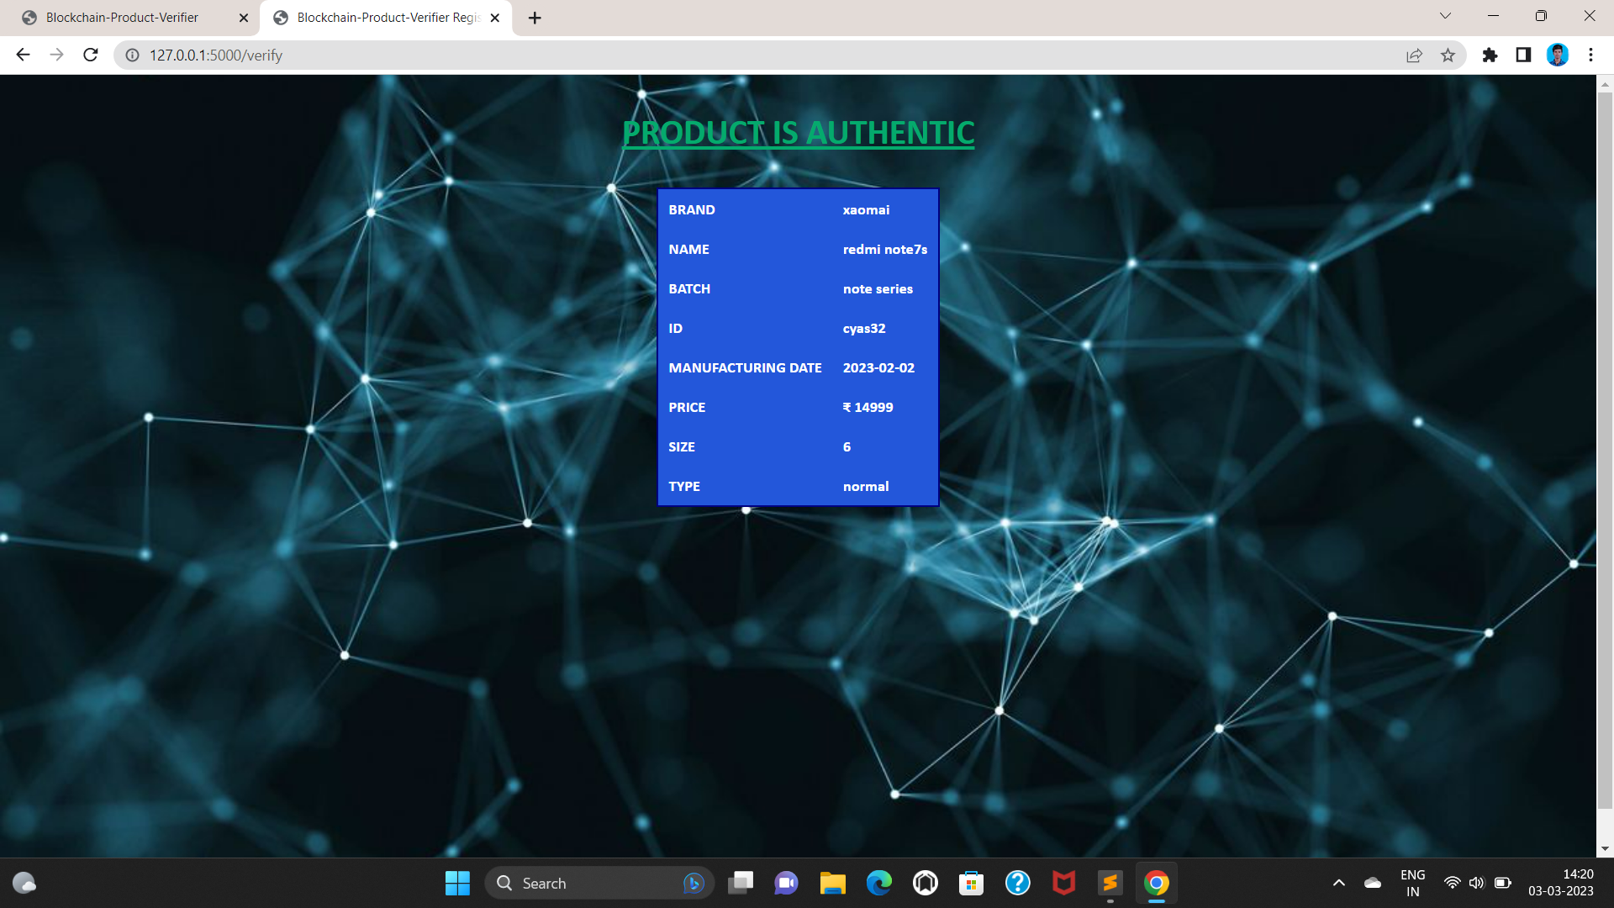
Verification module2: Product authentic page: In this section if the qrcode is authentic to the product details and it show the product information

Slide 36
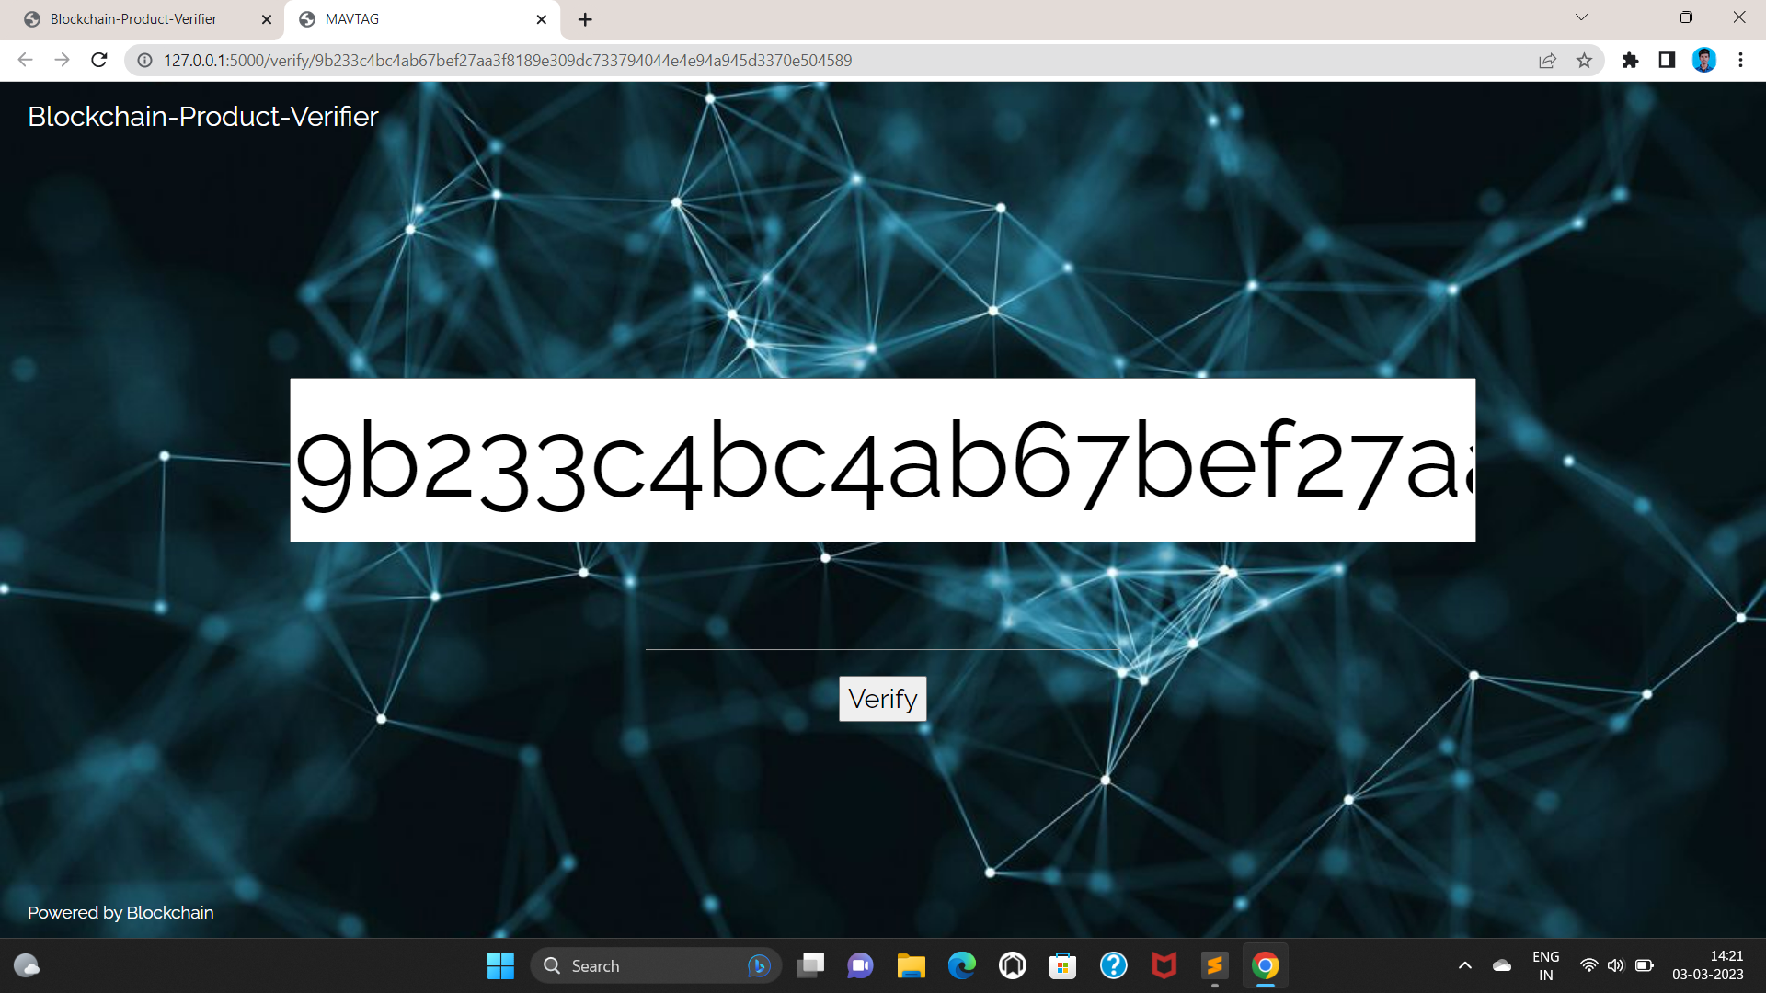
VERIFICATION MODULE3: Verification Page: In This Section Admin And consumer to be verify the fake qrcode to the value of the product.

Slide 37
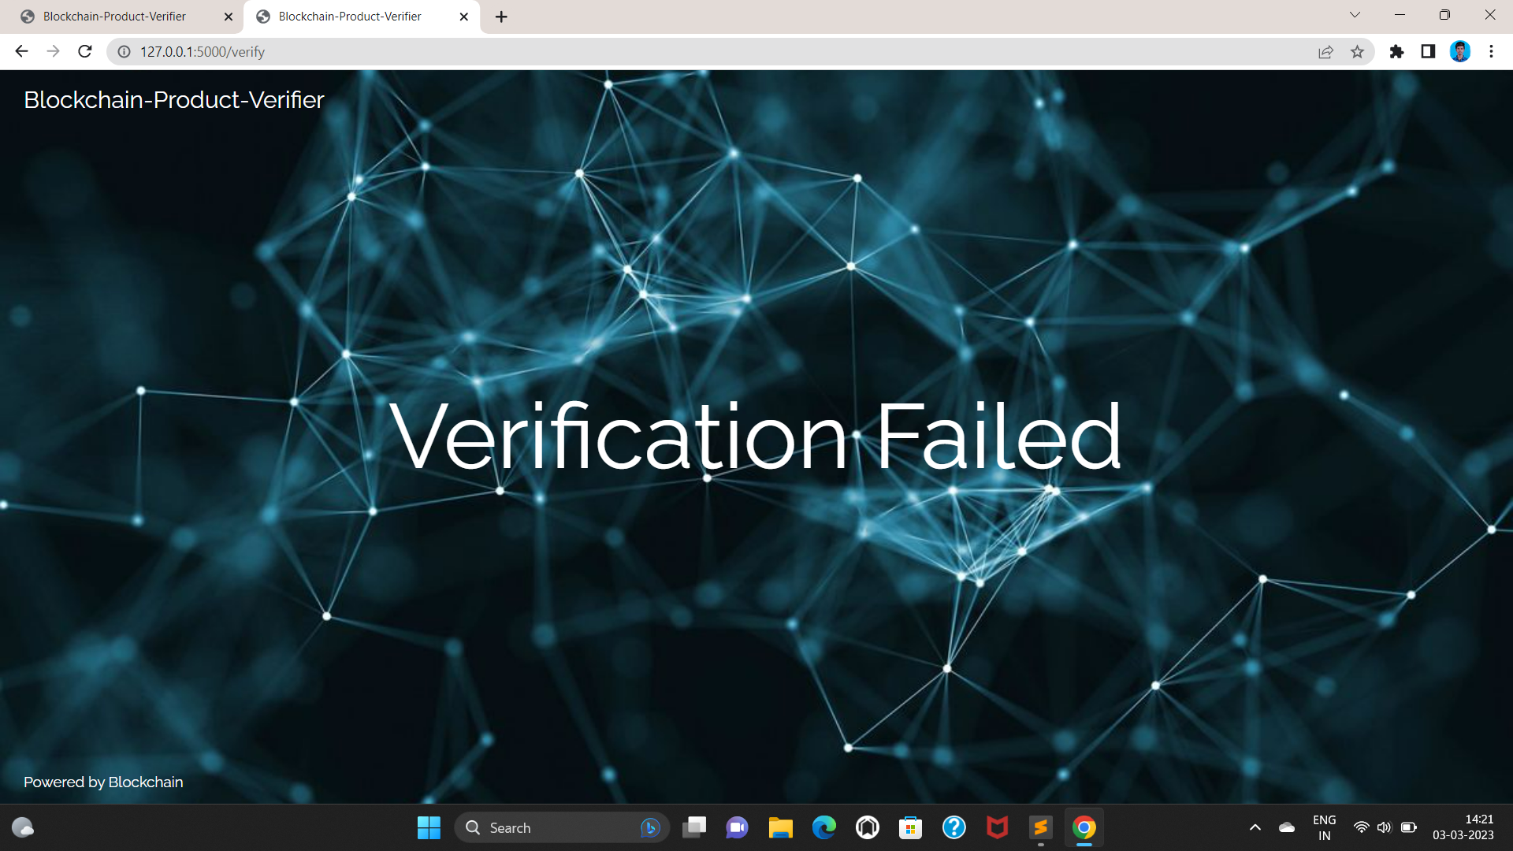
Verification module4: Verification failed page: In this section if the qrcode is not authentic to the product details and it show verification failed.

Slide 38
FUTURE SCOPE
1. Simplified code: Simplify the blockchain codebase for user-friendliness and wider adoption.
2. Counterfeit-resistant blockchain: Develop a robust system to combat counterfeiting and ensure product traceability with genuine warranties.
3. Cross-border product tracing: Leverage blockchain's distributed nature to create a comprehensive framework for tracking products and sellers globally.
4. Collaboration and data sharing: Foster collaboration among stakeholders and implement efficient data sharing mechanisms for successful implementation.
These future scopes aim to enhance the usability, security, and transparency of blockchain technology in combating counterfeiting and creating a reliable marketplace.

Slide 39
CONCLUSION
Blockchain technology revolutionizes counterfeit product identification. It ensures transparency, simplifies code, and enhances consumer trust. Integration of warranties and smart contracts strengthens identification processes.
Cross-border tracing facilitates global collaboration. Collaboration, protocols, and data sharing are crucial. Blockchain transforms the landscape, but more research is needed for optimization and effective counterfeiting prevention.
We will create a system that manages and monitors product transportation information in the future.

Slide 40
REFERENCEs
[1] Satoshi Nakamoto, ―Bitcoin: A Peer-to-Peer Electronic Cash System‖, 2008
[2] Hyperledger, ―Hyperledger Blockchain Performance Metrics‖, V1.01, October 2018
[3] R.C. Merkle, "Protocols for public key cryptosystems," In Proc. 1980 Symposium on Security and Privacy, IEEE Computer Society, pages 122-133, April 1980.
[4] Armin Ronacher, ―Flask Docs‖, http://flask.pocoo.org/docs/‖
[5] G. Wood, ‗‗Ethereum: A secure decentralised generalized transaction ledger,‘‘ Tech. Rep., 2014.
[6] OECD (2016), Illicit Trade: Converging Criminal Networks, OECD Reviews of Risk Management Policies, OECD Publishing, Paris, https://doi.org/10.1787/9789264251847-en.
[7] M. Castro and B. Liskov, ‗‗Practical byzantine fault tolerance and proactive recovery,‘‘ ACM Trans. Comput. Syst., vol. 20, no. 4, pp. 398– 461, Nov. 2002.

Slide 41
THANK YOU !

